Slide 1
Agentic RAG Chatbot for Multi-Format Document QA using MCP

Slide 2
Project Overview
A document-question answering system
Uses multi-agent architecture (Ingestion, Retrieval, Response)
Supports file uploads (PDF, DOCX, PPTX, CSV, TXT, MD)
Interactive chatbot UI built with Streamlit

Slide 3
Tech Stack
Component | Tools Used
UI | Streamlit
Parsing | pandas, python-docx, PyMuPDF, python-pptx, etc.
Embedding | sentence-transformers (MiniLM)
Vector Search | FAISS
Language Model | Google Gemini (google-generativeai)

Slide 4
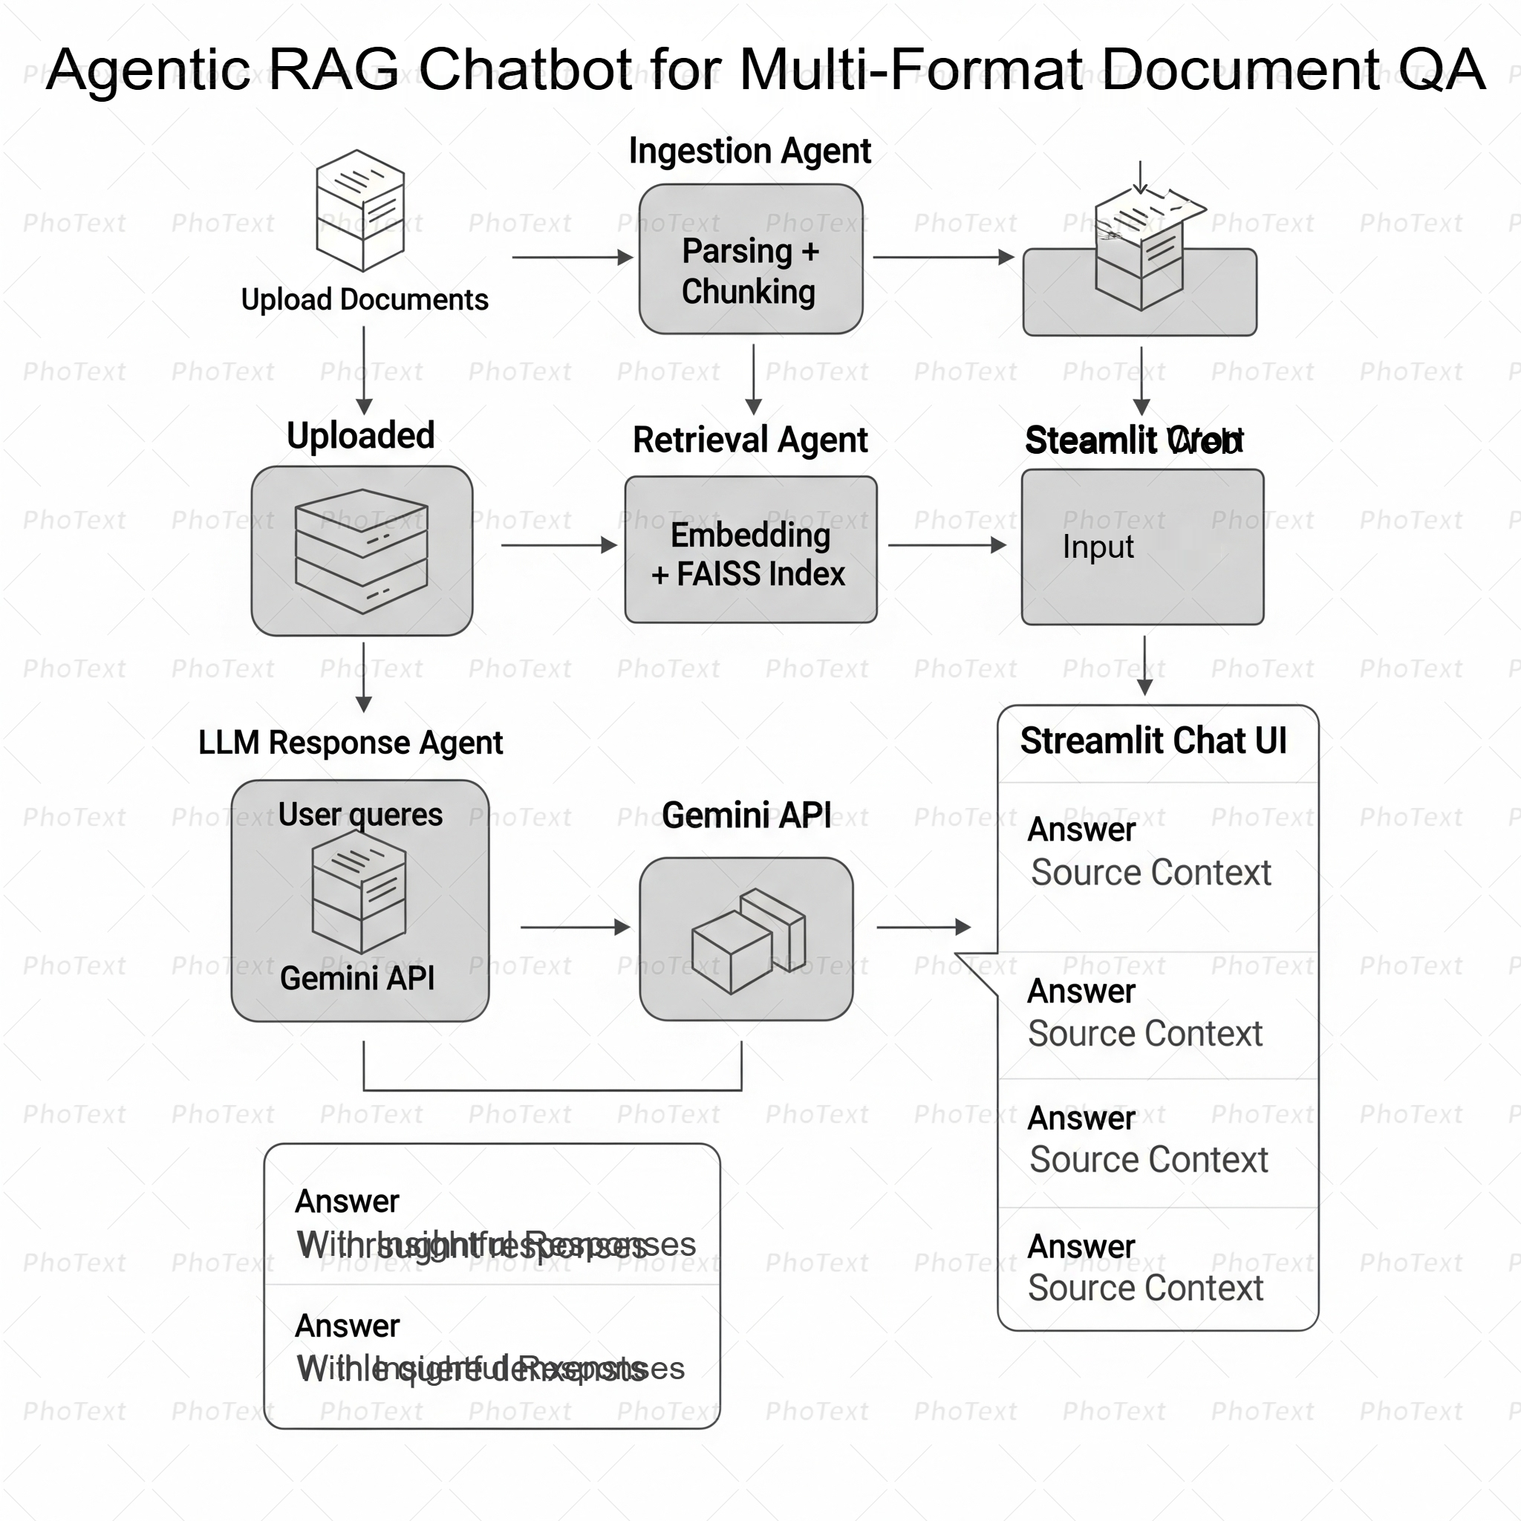
System Architecture

Slide 5
Multi Agents
IngestionAgent
Parses uploaded documents using a file-type-specific parser
Supported formats: PDF, DOCX, PPTX, CSV, TXT, Markdown
Converts raw content into 500-word text chunks
Each chunk is tagged with its source filename
Sends structured message to RetrievalAgent
RetrievalAgent
Generates vector embeddings for each chunk using SentenceTransformers
Builds a FAISS index to store and search chunk vectors
On user query, computes query embedding
Retrieves top-k most relevant chunks using similarity search
Sends retrieved context to LLMResponseAgent

Slide 6
LLMResponseAgent
Receives the user query and retrieved context chunks
Constructs a prompt using query + context
Sends the prompt to Gemini API (via google.generativeai)
Receives and formats the model's final answer
Sends answer and source context to Streamlit Chat UI
Streamlit Interface
File Uploader
Allows users to upload multiple files
Supported formats: PDF, DOCX, PPTX, CSV, TXT, MD
Process Documents" Button
Triggers the document ingestion process
Initializes IngestionAgent, RetrievalAgent, and LLMResponseAgent
Chat Input & Output
Users can type natural language questions
Displays assistant’s response and user’s question in a chat-style layout
Source Context Expander
Expands to show the original document chunks used in answering the question
Ensures transparency and explainability in responses

Slide 7
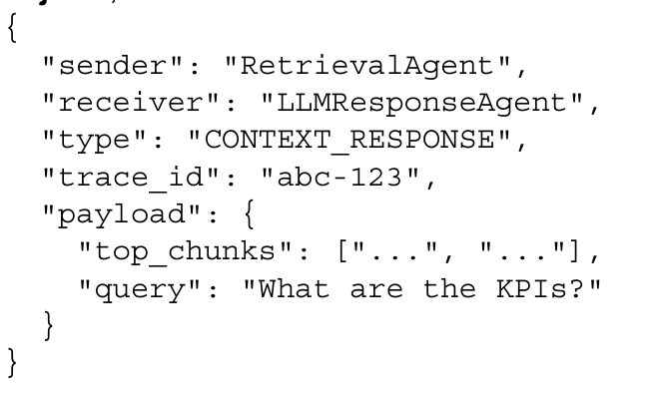
Message Context Protocol (MCP)
Purpose of MCP
Acts as a standardized communication format between agents (Ingestion, Retrieval, LLM Response)
Ensures consistent structure of information exchange
Why We Use MCP Structure of an MCP Message
Enables modular and scalable architecture
Makes agent coordination explicit and traceable
Useful for debugging and maintaining message flow
Examples in Project
📄 IngestionAgent sends a message with file chunks to RetrievalAgent
🔍 RetrievalAgent sends retrieved chunks and query to LLMResponseAgent
💬 LLMResponseAgent sends the final answer back to the Streamlit UI

Slide 8
Challenges faced
Keeping UI Minimal Yet Functional: Balancing between a clean UI and supporting all features like uploads, queries, responses, and source visibility.
State Management in Streamlit: Maintaining proper session state for uploaded files, processed agents, and chat history.
Chunking Strategy: Designing a generic chunking method suitable for different document types without breaking context.
Parsing Multi-Format Documents: Handling diverse file types like PDF, DOCX, PPTX, CSV, etc., and extracting clean, structured text.

Slide 9
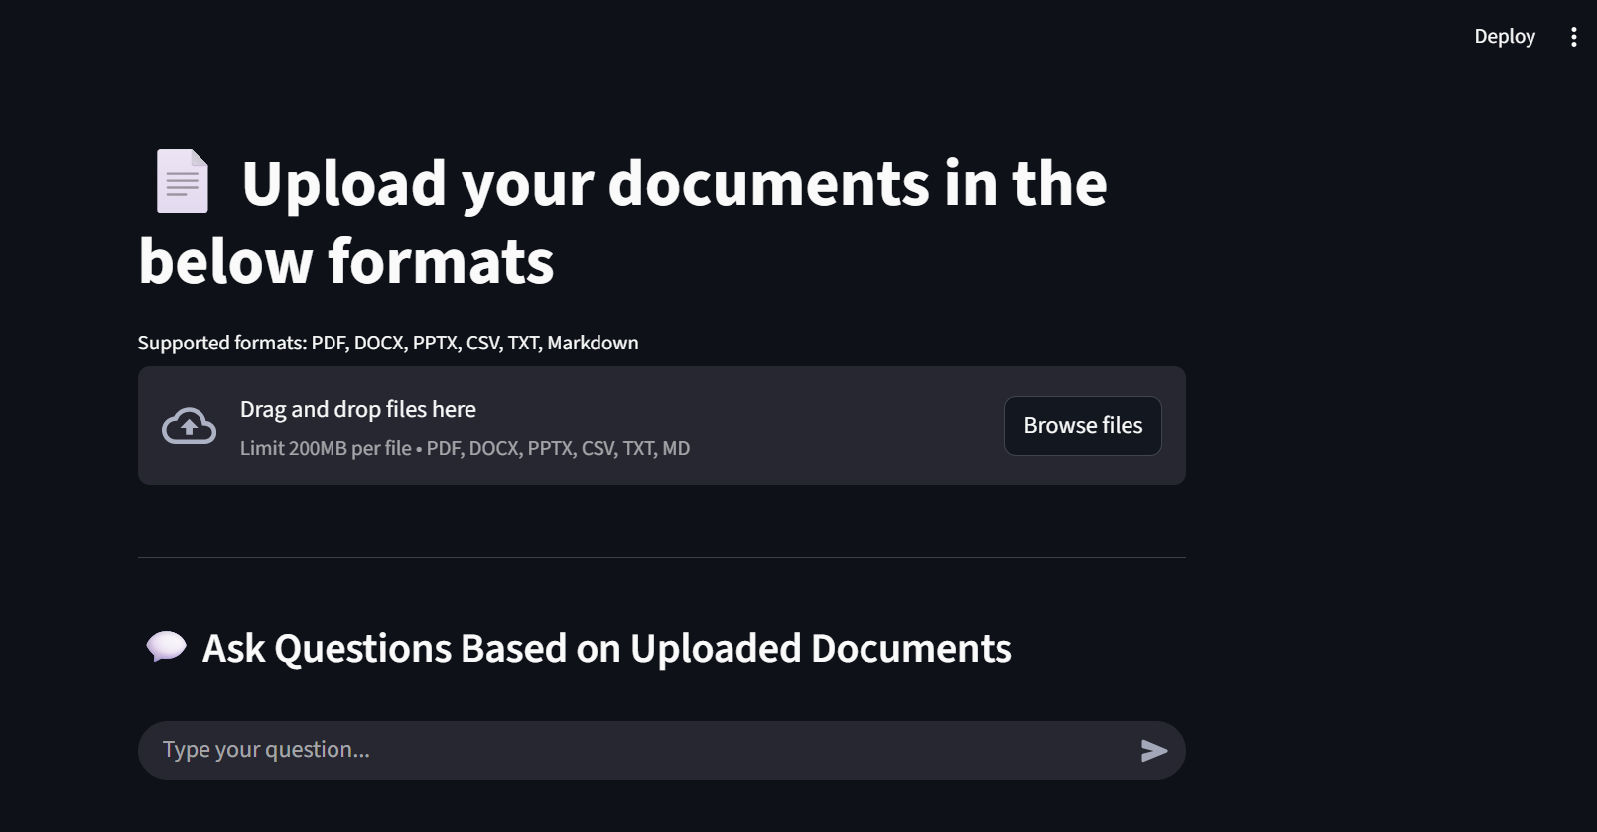
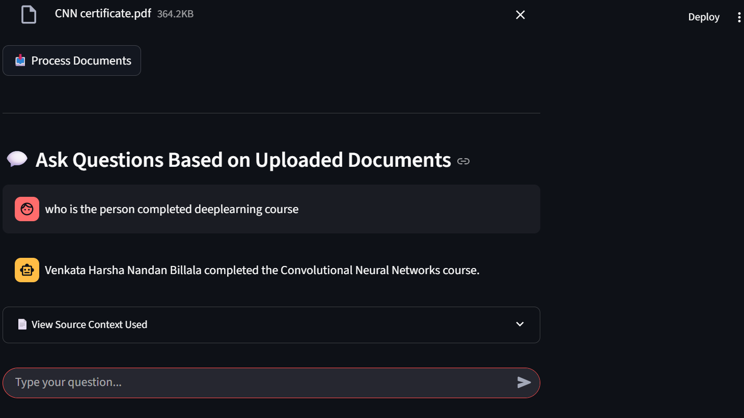
Output

Slide 10
Thank you
Venkata Harsha Nandan Billala
8374508814
bvhn1355@gmail.com

